Slide 1
When life becomes challenging, finding help shouldn’t be.

Slide 2
Who we are
Center For Family Services is a leading non-profit social services provider offering a strong and innovative continuum of care with comprehensive and evidence-based services. Headquartered in Camden City, Egg Harbor Township, East Orange, and Washington, New Jersey, Center For Family Services offers life-changing services in convenient and accessible locations across the state.
Center For Family Services is an employer and a service provider dedicated to diversity, equity and inclusion. Cultural competence and awareness is a critical component of workplace culture and service delivery.

Slide 3
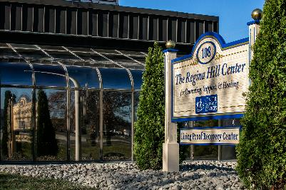
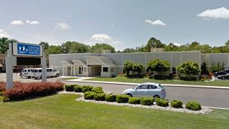
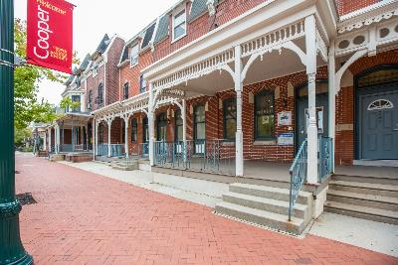
Locations
Center For Family Services has over 100 locations across New Jersey.
Notes:
Center For Family Services has over 80 locations across New Jersey and provides services in Atlantic, Burlington, Camden, Cape May, Cumberland, Essex, Gloucester, Morris, Ocean, Passaic, Salem, and Sussex counties

Slide 4
Our Mission and Vision
The mission of Center For Family Services is to support and empower individuals, families, and communities to achieve a better life through vision, hope, and strength.
The vision of Center For Family Services is for all people to lead capable, responsible, fulfilled lives in strong families and healthy communities.
Notes:
As an organization, we rally around a common goal in changing and strengthening lives. Together we bring our talents, knowledge, experiences, and expertise to provide life-changing services to our community.

Slide 5
Our Company Culture
Team-focused
Family-oriented
Mission-driven
Community-focused
Compassionate
Open minded
Change makers
“Whatever it takes” attitude
Forward thinking

Slide 6
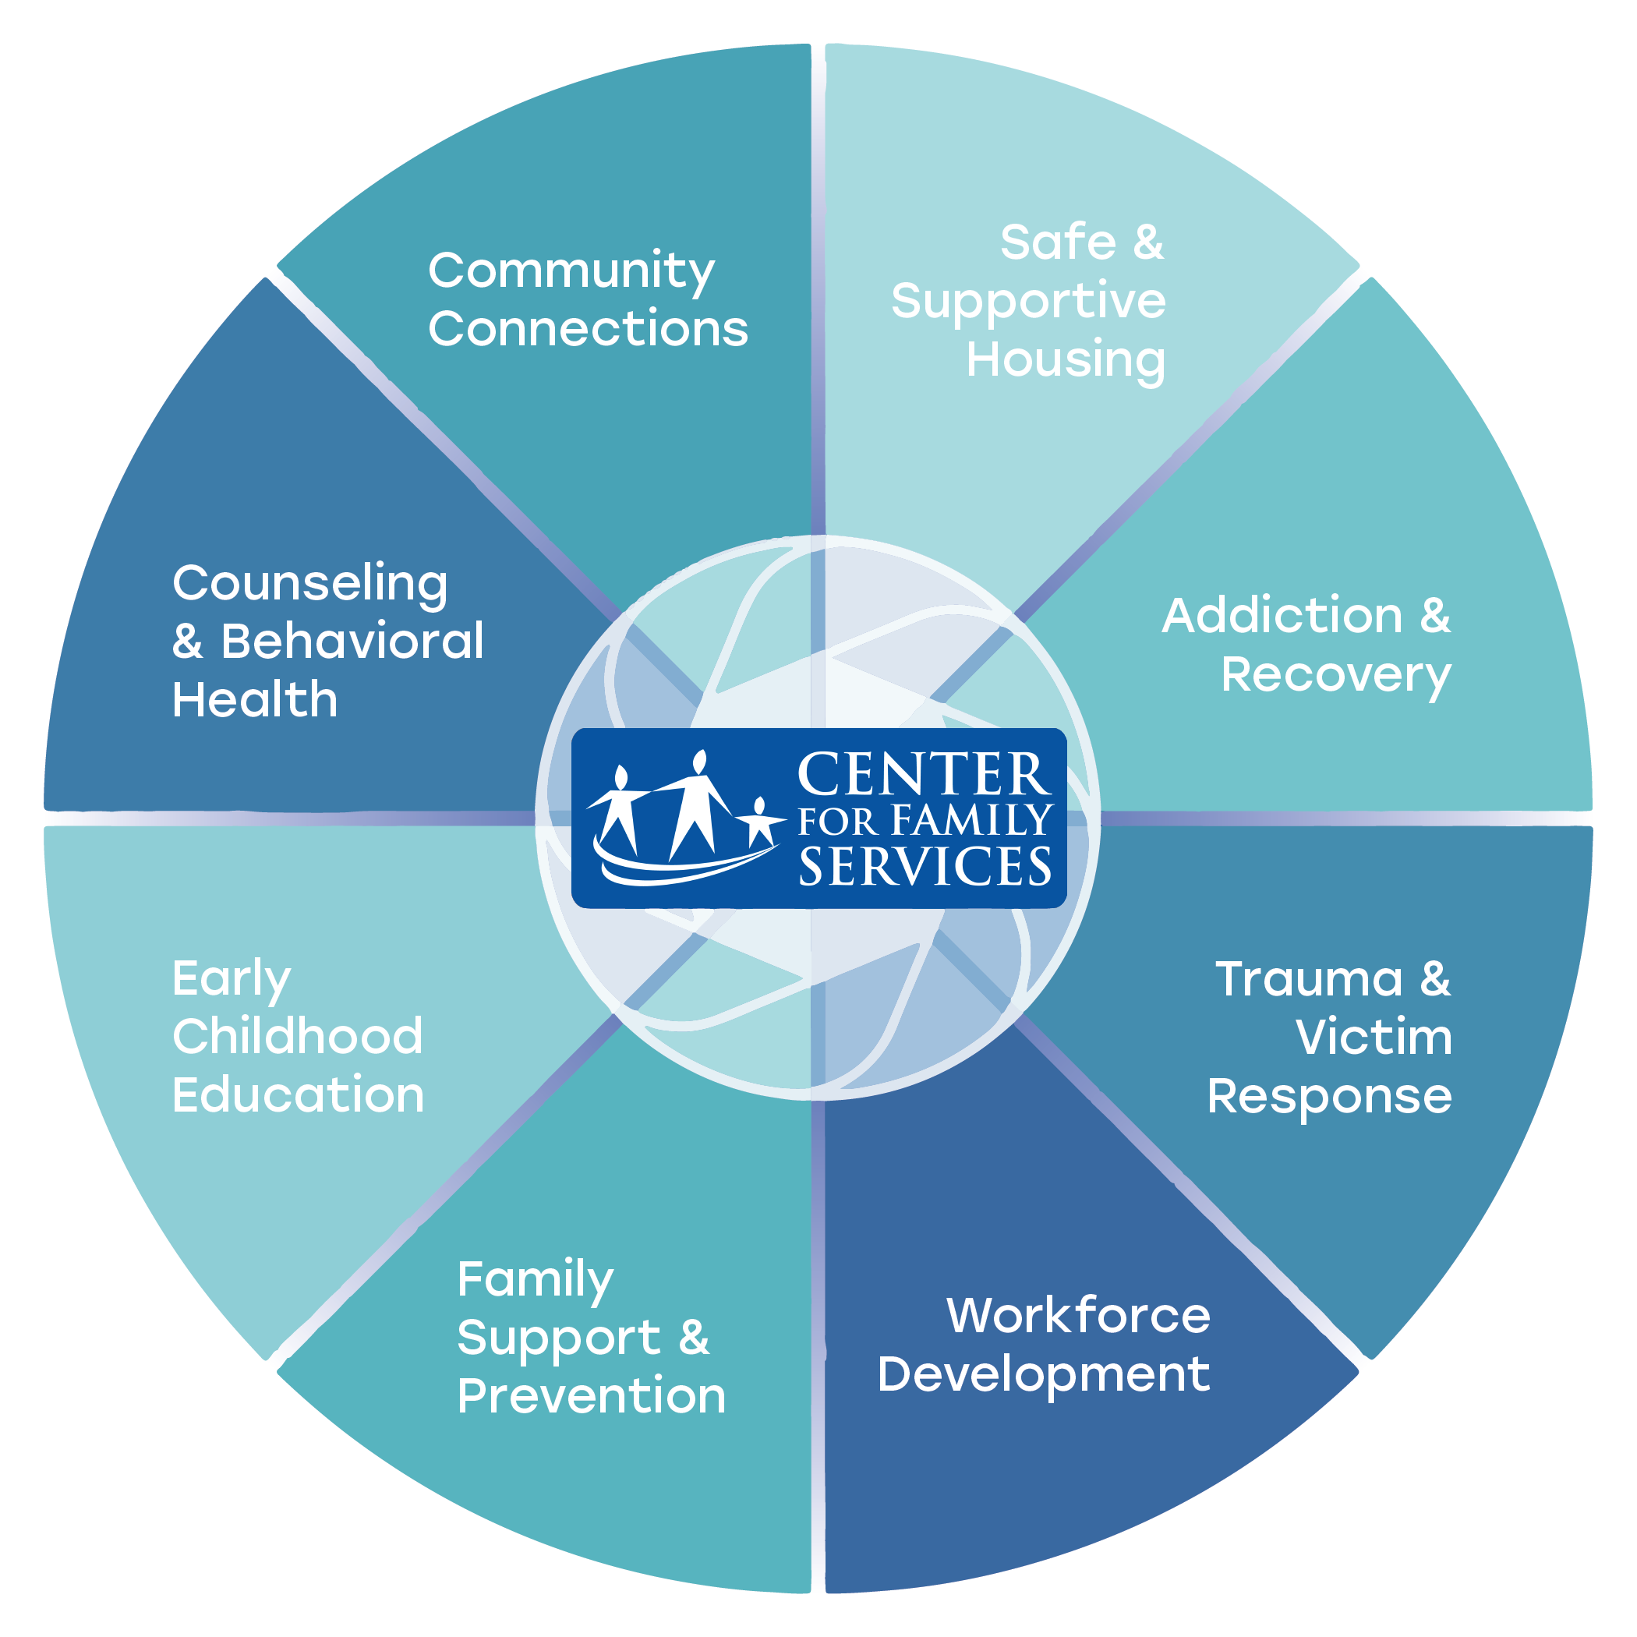
Service Areas
Center For Family Services offers a comprehensive continuum of care and a broad range of services to best meet the current and changing needs across the New Jersey community.
Notes:
Through more than 90 programs, the Center For Family Services’ network of 1500+ staff works closely with individuals and families to develop solutions to difficulties they may be facing and create paths for greater self-sufficiency.

Slide 7
Core Values
Culture of Respect
Service – focused
Ethical
Moral
Diverse
Leaders
Accountability
Gratitude
Progressive
Excellence
Notes:
Our core values highlight what we stand for. They define who we are as an organization. Our core values guide our behaviors, our desires, our actions. They help us to determine if the organization is fulfilling our goals.
In this ever-changing industry, core values are constant. As you join our team, do your best to follow these values that we have put into place and I believe you will then understand how these values help us to maintain our presence as a leading social services agency and the far-reaching goal of changing lives around us.

Slide 8
Continuous Quality Improvement
Council on Accreditation
CQIP Committee
Evidence based programming
Policy development
Best practices
Improving compliance
Funders & licensing requirements
Notes:
Center For Family Services participates in an accreditation process every three years.
Experienced reviewers shared that Center For Family Services is one of the best organizations they have ever reviewed. This is a testament to our long-standing success as a social services provider and commitment to providing high-quality, innovative care to individuals and families. We are proud to be accredited, as it is a measure of excellence to gauge how well we truly live our mission and core values.

Slide 9
Advocacy
We intervene for the individuals and families we serve on more than just a micro level.
As an agency, we also are a leader in the community and lend our voice for macro level change.
Advocate for policy change
Legislation
Educating legislators
Coalitions
Notes:
Center For Family Services changes the lives of people in need on more than just a micro level. Like FSA, we are a leader in the community in bringing change at the macro level as well.

Slide 10
TITLE
Add content

Slide 11
TITLE
Add content

Slide 12
TITLE
Add content

Slide 13
TITLE
Add content

Slide 14
TITLE
Add content

Slide 15
Experienced Care

